Slide 1

Linear Relatioships
Yr 12 Essentials

Slide 2
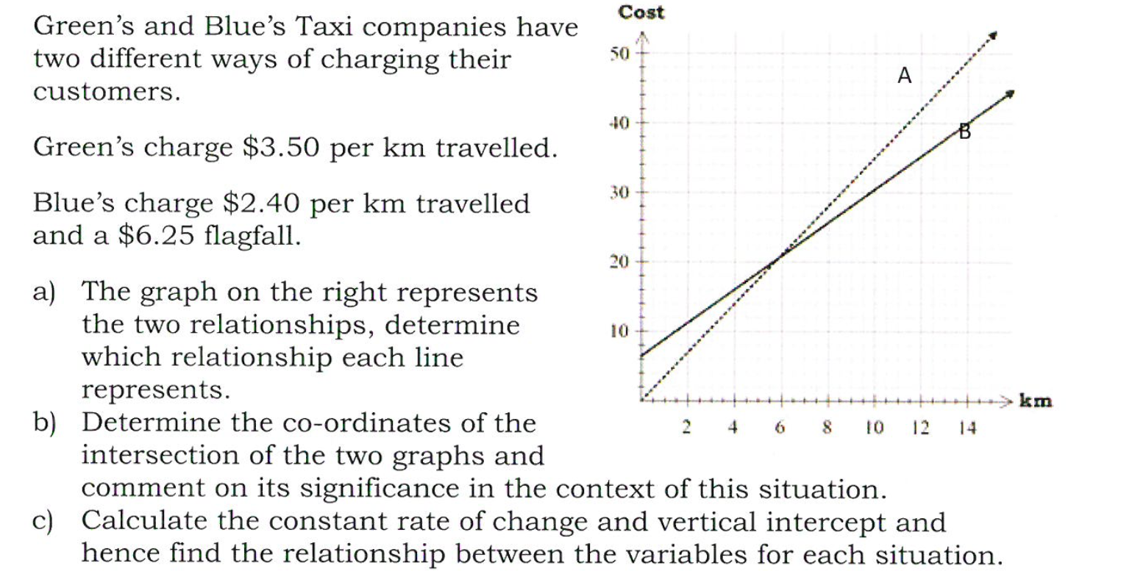
Linear Relationships
Opening Problem

Slide 3
Chapter 24 Exercises Qu 1-3 pg 87-88

